Slide 1

AI-POWERED CODE ANALYSIS
AI-Based Code
Quality
Analyzer
Hybrid Static Analysis & Multi-LLM Review Workflow
Presented By: Jainab Bee

Slide 2






The Problem Statement
Review Bottlenecks
Technical Debt
Inconsistency
Manual code reviews are time-intensive, causing deployment delays and engineer burnout in fast-paced teams.
Complexity often accumulates silently without metrics, leading to brittle and unmaintainable codebases over time.
Varied developer standards result in fragmented code quality, making it difficult to maintain unified best practices.

Slide 3


Core Mission & Objectives
Static Triage: Immediate identification of "code smells" and structural issues using AST parsing.
Metric Analysis: Quantifiable maintainability through industry-standard Cyclomatic Complexity metrics.
AI Reasoning: Leveraging Generative AI to provide context-aware and actionable refactoring advice.
Workflow Automation: Continuous quality enforcement through automated Git Hook integration.

Slide 4
The Technical Stack
Layer | Technology | Role in System
Parsing Engine | ast (Python StdLib) | Abstract Syntax Tree mapping for structural inspection.
Quality Metrics | radon | Calculation of Complexity and Maintainability Index.
Intelligence | Gemini / Ollama | Hybrid cloud/local LLM feedback relay mechanism.
User Interface | Streamlit | Interactive dashboard for real-time code evaluation.

Slide 5

Module 1: Structural Analysis
AST Extraction
Complexity Calculation
Maps imports, functions, classes, and loops using ast.walk() to build a comprehensive logic map of the source file.
Custom cyclomatic_complexity_ast counts decision nodes (If, For, While, Try) to measure logical depth.
> Validation enforced via safe_parse error handling.

Slide 6


Module 2: Issue Detection
Naming Standards
Documentation
Issue Severity
Flags function/variable identifiers under 4 characters to ensure meaningful self-documentation.
Verifies existence of docstrings across all defined classes and functions to maintain high readability.
Classifies detected smells into INFO, WARNING, or CRITICAL levels.

Slide 7

Module 3: Scoring & Metrics
Quantitative Health Score
90+
Final health grade is calculated by applying penalties to a base score of 100 based on:
Critical Penalty: High Complexity (CC > 10)
EXCELLENT GRADE
Maintenance Penalty: MI < 65

Slide 8


Module 4: The AI Engine
Hybrid Intelligence Relay
The feedback engine utilizes a fail-safe hierarchy to ensure intelligent review is always available:
1.
OpenRouter: Primary cloud-based high-reasoning models.
2.
Ollama: Privacy-first local fallback for offline environments.
3.
Gemini: Direct Google AI integration for Python refactoring.
Note: Fallback to static rule-based tips if AI engines are unreachable.

Slide 9
Module 5: Git Hook Integration
Commit Trigger
Staged Scan
Validation
Gate Result
Hook script intercepts the git commit action.
Analyzes only staged changes to ensure rapid developer feedback.
Evaluates code against the "Critical Issue" gatekeeper rules.
Blocks commit if serious issues are found, ensuring clean history.

Slide 10
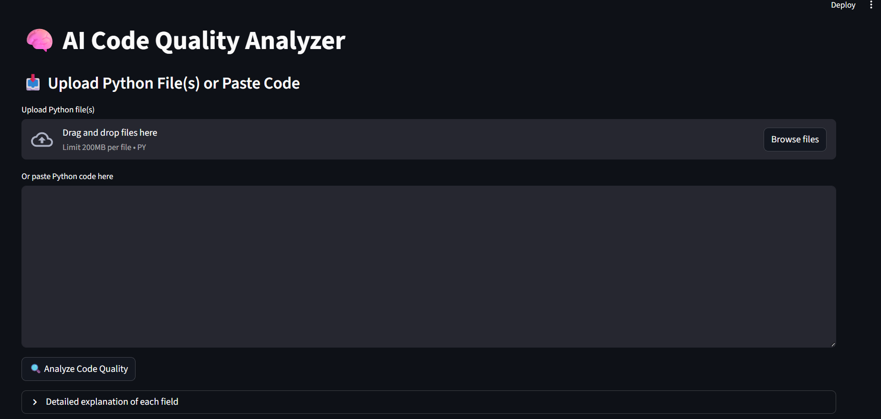
Module 6: Frontend UX
Interactive Dashboard
A streamlined Streamlit interface designed for rapid developer onboarding:
Dual-Input: Multi-file upload or code paste.
Metrics: Project Score and Complexity gauges.
Reports: Downloadable CSV and HTML summaries.

Slide 11






Key Features Summary
Auto-Fix Engine
Configurability
Actionable Tips
Automated cleaning of debug prints and formatting based on static smell detection.
Custom thresholds and exclusion rules defined via project toml files.
Concise, prioritized feedback lists for immediate refactoring and code improvement.

Slide 12

Future Work & Roadmap
Multi-Language: Expanding AST parsing rules for Java and JavaScript support.
CI/CD Integration: Seamless cloud-native runners for GitHub Actions and GitLab CI.
Advanced Security: Vulnerability scanning for dependencies and OWASP rule-checking.
Self-Learning: Fine-tuning local models on project-specific coding styles.

Slide 13

Conclusion
95%
The AI-Based Code Quality Analyzer streamlines the development lifecycle by bridging the gap between deterministic static analysis and human-like reasoning.
AUTOMATION COVERAGE
Standardizing quality. One commit at a time.

Slide 14
Questions?
Thank you for your attention!
https://github.com/jainab-bee/code_analyzer.git

